Slide 1
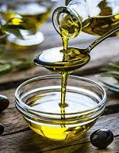
VIRGIN OLIVE OIL EXTRa
THE PRINCE OF OUR MEDITERRANEAN DIET

Slide 2
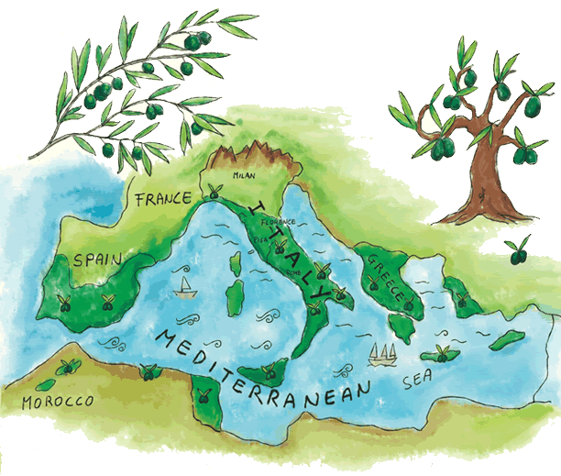
Calabria is the second Italian region by olive oil production
The cultivation of the olive tree in Calabria has very ancient origins: it is assumed, in fact, that the cultivation of the olive tree dates back to the beginning of the first millennium a. C., when first the Phoenicians and then the Greeks to whom the dominations of the Romans, the Byzantines, the Lombards, the Normans, the Angevins and the Aragonese followed; all the sovereigns had to deal with the great olive wealth of Calabria. The varieties grown in Calabria are: Carolea, Sinopolese, Dolce di Rossano and Grossa di Gerace which are flanked by Ottobratica, Roggianella and Cassanese.

Slide 3
Olive or olive tree: evergreen fruit plant
The olive tree grows on the sunny hills and lives many years. The trunk is gnarled and twisted. The leaves of the olive tree have the shape of the tip of a spear. The fruit of the olive tree is cgiama olive or olive.

Slide 4
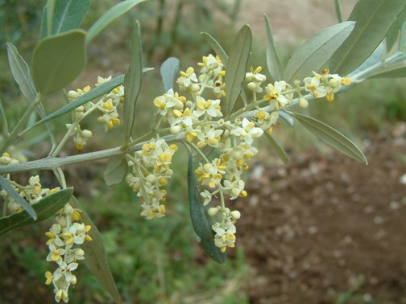
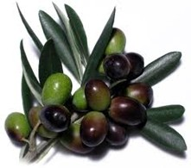
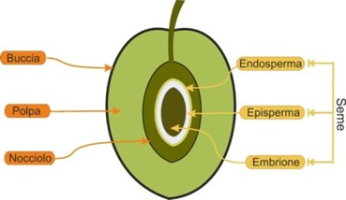
The Flowers of the olive tree are called Mignole, it is a small white flower with four petals.
I Fruits are called olives or olives and after a long transformation it becomes oil and is used in our diet.
It is a fleshy fruit, externally there is the peel, internally there is the pulp from which the oil is extracted, in the central part there is the stone.

Slide 5
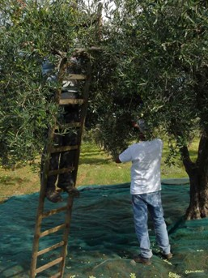
The olive harvest
For the olive harvest, wooden bars, rakes, mechanical sgrullini, shakers and awnings or nets are used.

Slide 6
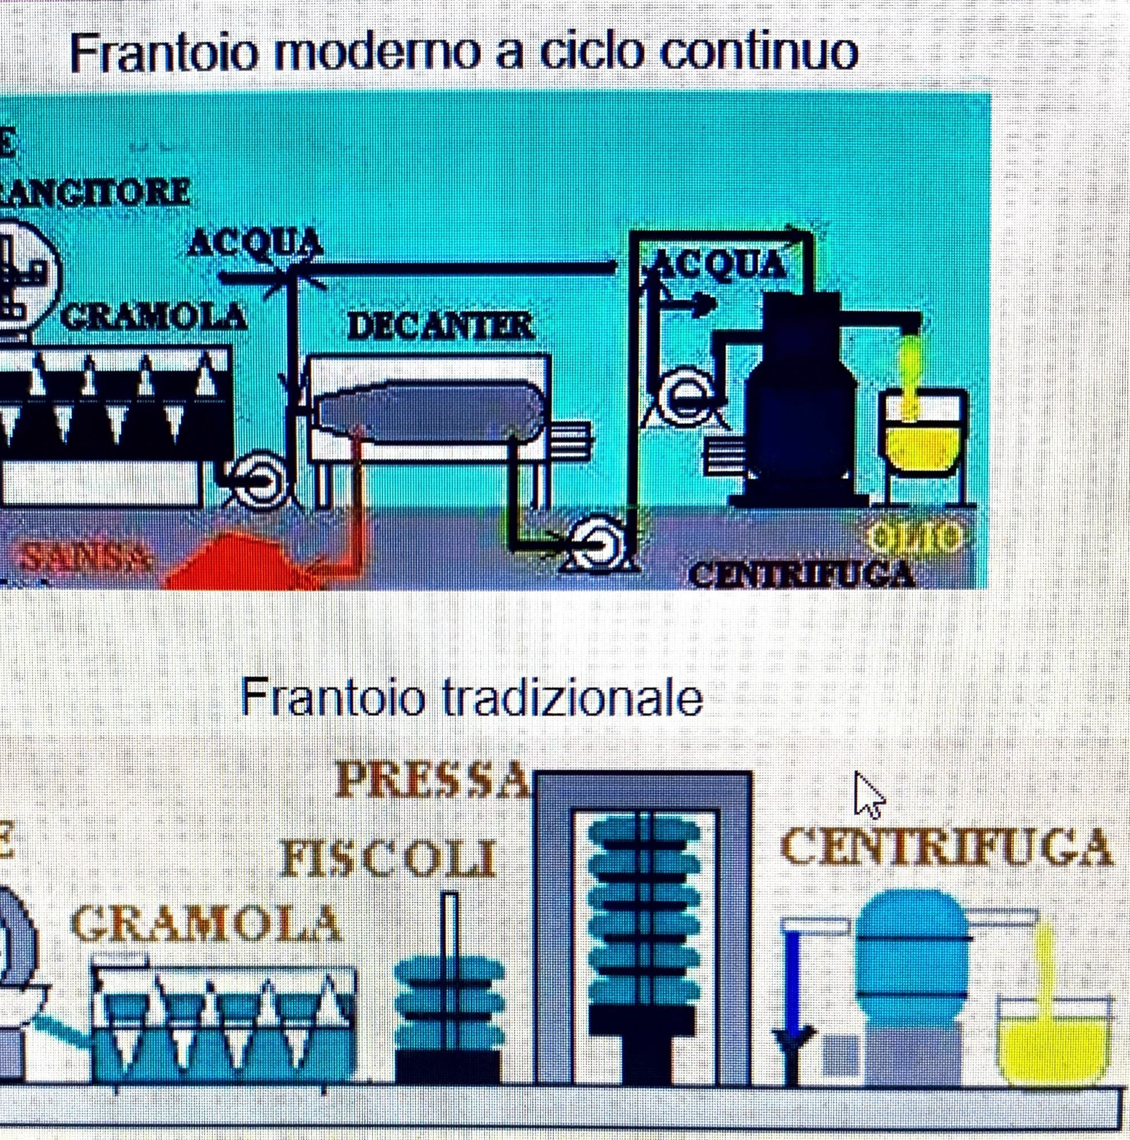
The olives are transported to the mill Washing of the Olives that takes place with normal water. Grinding of the olives including the kernels to form a homogeneous paste (recommended to grind the olives within 24 hours of harvest). Separation of the solid and liquid phase: This process takes place by centrifigation of the paste (continuous modern systems) or by pressing (old system but still used). It is important that the temperature during this phase does not exceed 27 C. In this case we can talk about Cold Pressing. Oil storage in steel containers (modern systems) closed and protected from light and heat (recommended temperatures of 15-18 C).

Slide 7
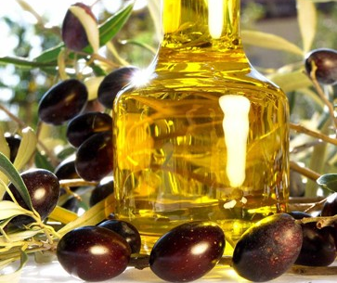
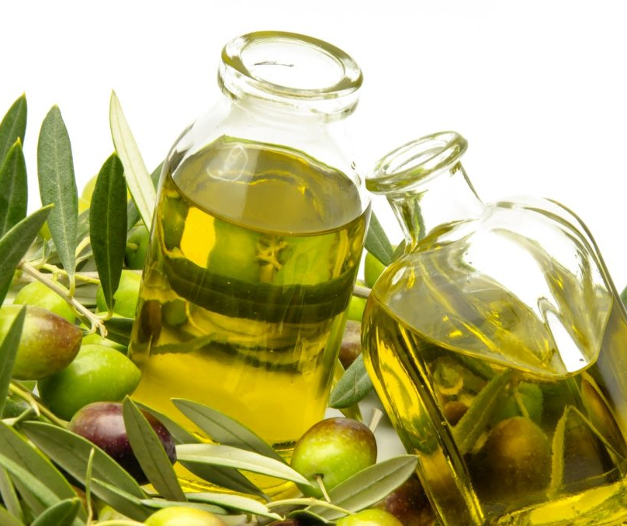
Extra Virgin Olive Oil is a natural and healthy ingredient that is used daily in the preparation of many dishes of Italian cuisine.

Slide 8
Science activities: HEALTHY AND BALANCED DIET « Extra virgin olive oil: the prince of our Mediterranean diet». Classes 5 ^ of the Comprehensive Institute Crosia- Mirto (via dell'Arte, via del Sole and Sorrenti) TEACHERS: Celestino R.L. – Muraca M. – Santoro A.- Romano A. Capristo T. Erasmus+ KA 122 Seasonal@Glocal Mobility for individual learning FUNDED BY THE EUROPEAN COMMUNITYPROJECT CODE: 2021-1-IT02-KA122-SCH-000013562

